Slide 1
What if...there was a dinosaur called a roof lizard?

Slide 2
A Roof Lizard
(Draw what you think a Roof Lizard might look like)

Slide 3
The roof lizard is as big as a bus! It walks on four legs, but its front legs are shorter than its hind legs. While it has five toes on each of its front feet, its back feet only have three toes each. Its head is very small in proportion to the rest of its body. In fact, its brain is no bigger than that of a dog. The roof lizard’s mouth is like a horny beak with no front teeth. Toward the back of its mouth, it has tiny, triangular teeth it uses to grind its food. Running along the spine of its arched back, from their neck to their tail, is a double row of kite shaped plates. At the end of its tail is a pair of long spikes.
(Now, using the description above, try drawing the Roof Lizard again.)

Slide 4
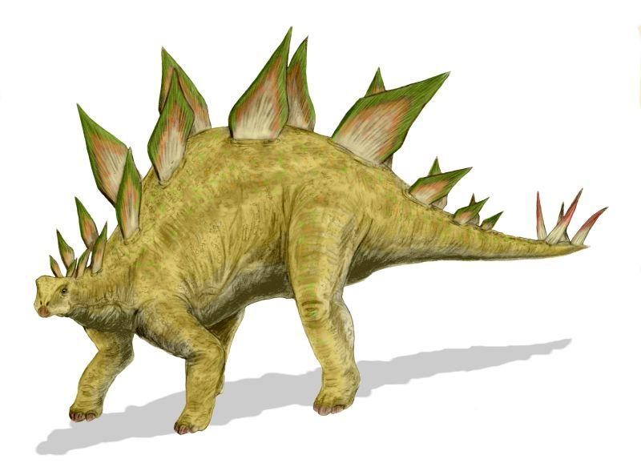
Meet the Roof Lizard!

Slide 5
Facts about the roof lizard
The roof lizard’s scientific name is: stegosaurus. This name is a combination of the Greek words, stegos (roof) and saurus (lizard).
While the roof lizard’s plates were most likely used to defend this plant eater from hungry, meat eating dinosaurs, scientists now believe they may have also been used to help regulate (control) this cold blooded lizard’s temperature.
In terms of helping to defend itself, its plates were probably more for show; the large plates made this enormous dinosaur even bigger. This increase in size could have been enough to convince predators to find an smaller target for lunch.
While its date of origin is not certain, it is believed to have roamed the Earth nearly 160 million years ago.
Scientists once believed that the roof lizard may have had a second brain.
It had a series of bones under its neck to protect its most vulnerable area from attack.
It is the state dinosaur of Colorado.

Slide 6
Describe your discovery in your own words.

Slide 7
What is it?

Slide 8
Who would be curious to know about it?

Slide 9
How does it live?

Slide 10
Where does it live?

Slide 11
When would be a good time to see it?

Slide 12
Why are they important to our planet?

Slide 13
Huh? What confuses you about it?

Slide 14
Wow! What makes it awesome?

